Slide 1
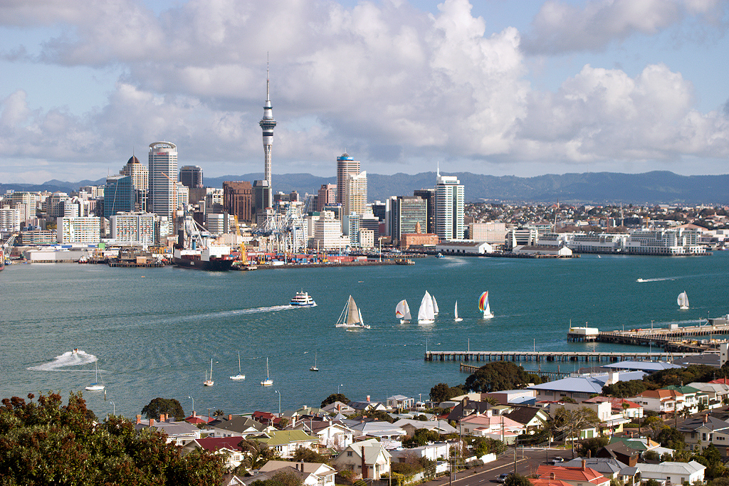
T - AKL
An Insider’s Guide to the City of Sails

Slide 2
Have you ever…
Found yourself in a new place?
Been bored and can’t think of anything to do?

Slide 3

[Logo comes here]

Slide 4
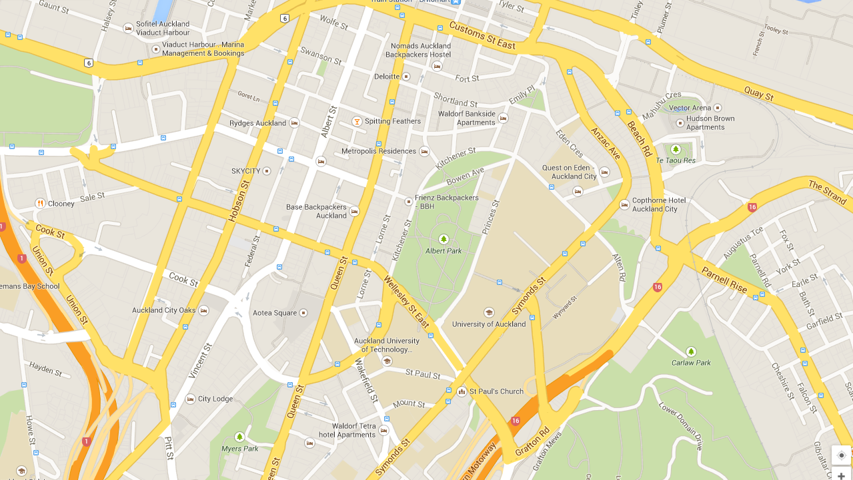
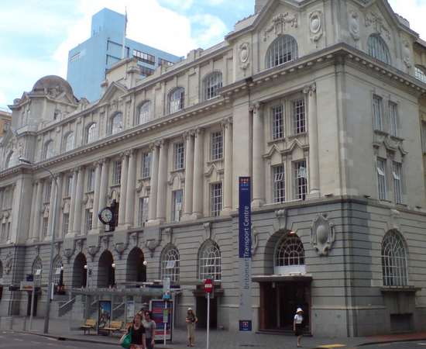
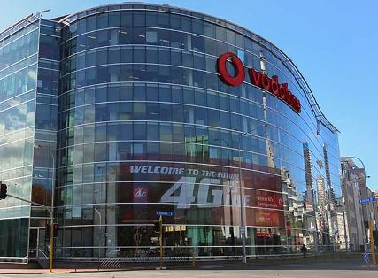
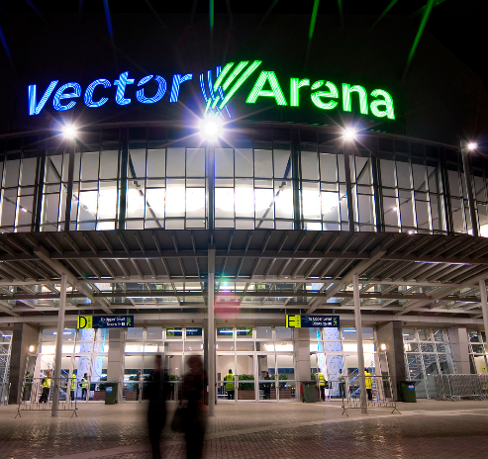
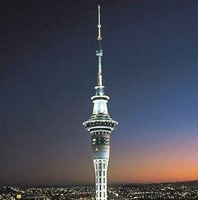
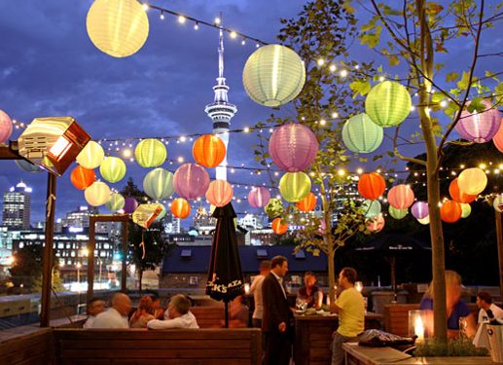
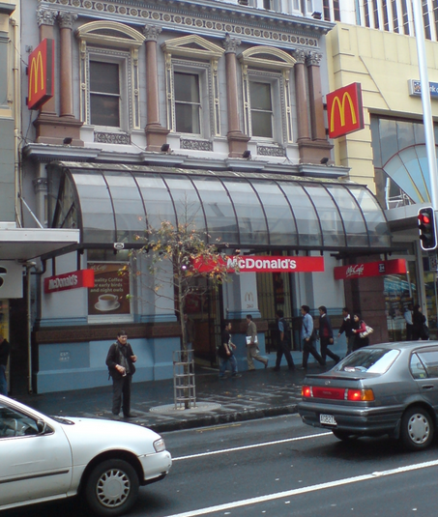
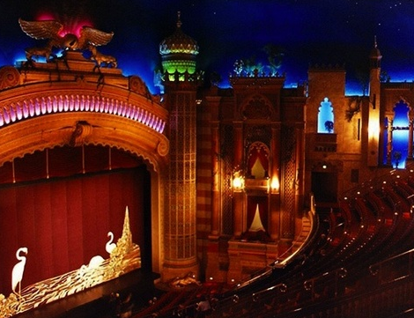
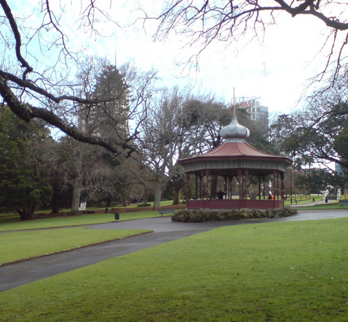
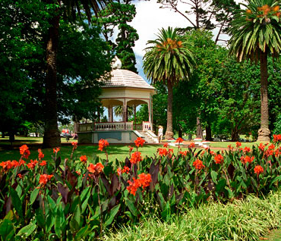
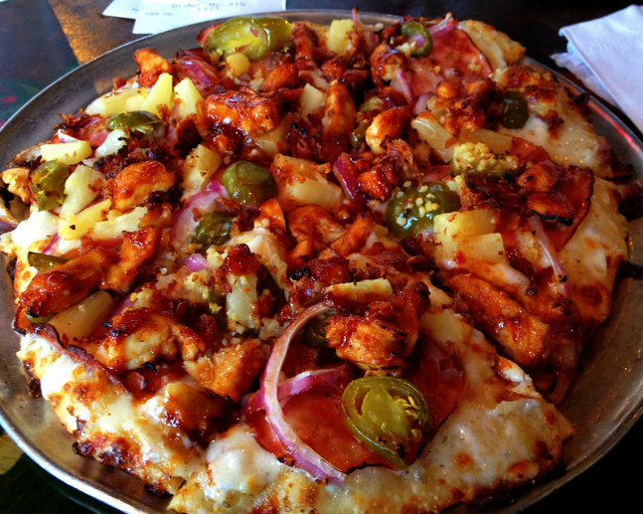
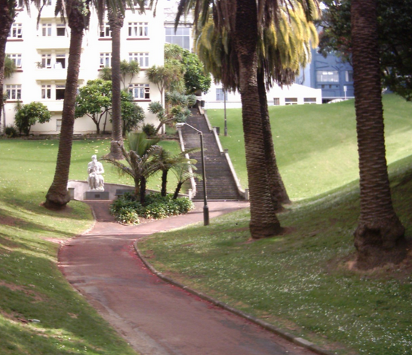

Slide 5
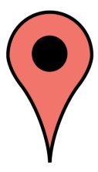


Features
Direct Upload with Geolocation
Love
Directions

Slide 6
Why?
Give people something to do!
Create explorers
Give people a reason to use public transport

Slide 7
Design Ideals
Speed
Simplicity
Trust

Slide 8
The next big thing…
Event Alerting
Enhanced Social Interaction
Recognize and Incentivize Customer Loyalty
Share with Family and Friends
POI Enroute

Slide 9
[Logo comes here]

